Slide 1
Geodesics in Heat
A New Approach to Computing Distance Based on Heat Flow
KEENAN CRANE Caltech CLARISSE WEISCHEDEL, MAX WARDETZKY University of Gottingen

Slide 2
What is it Geodesics?
A geodesic is a locally length-minimizing curve.
Equivalently, it is a path that a particle which is not accelerating would follow.
In the plane, the geodesics are straight lines.
On the sphere, the geodesics are great circles (like the equator).
The geodesics in a space depend on the Riemannian metric, which affects the notions of distance and acceleration.

Slide 3
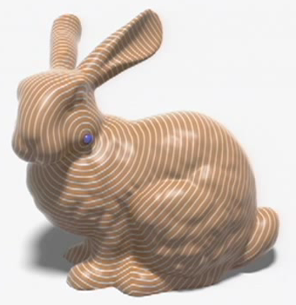
Problem
For a given domain (triangulated mesh, smooth surface, etc…) and a given subset of the domain (e.g., point or curve), we would like to find the shortest distance to every other point on the domain.

Slide 4
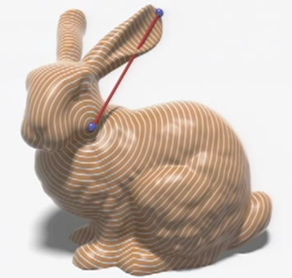
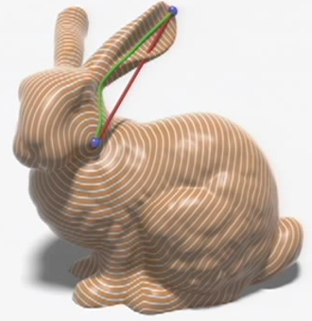
Problem
Finding the euclidean distances would be really easy to compute.
Instead, the length we are looking for is the length of the shortest path along the surface, in other words, the geodesic distance.
euclidean geodesic

Slide 5
Recent Solutions
Typically the way of solving this problem is by algorithms based on marching or sweeping.
The problem is that for any query point, we will compute the distances all over again and won’t be able to reuse data.
Another problem which appears is that the algorithms previously used vary for different domain representation (polygonal mesh, triangulated mesh, points cloud, etc..).

Slide 6
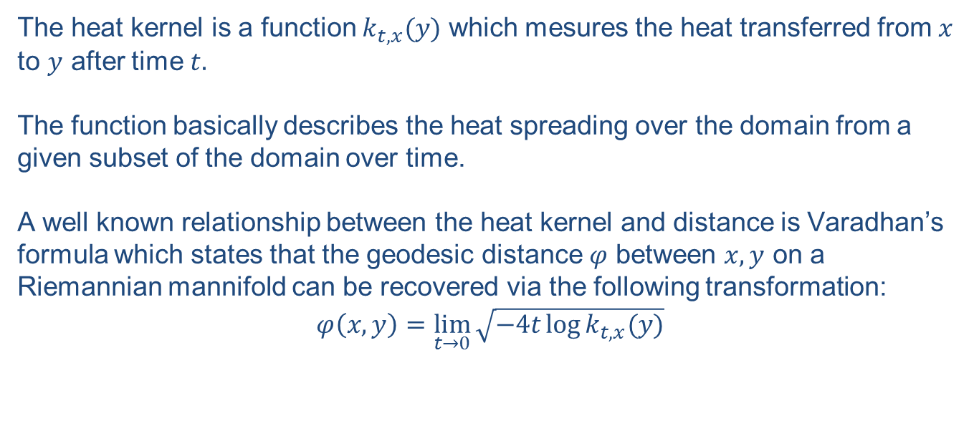
Heat Kernel
The heat kernel is a function $k_{t,x}(y)$ which mesures the heat transferred from $x$ to $y$ after time $t.$
The function basically describes the heat spreading over the domain from a given subset of the domain over time.
A well known relationship between the heat kernel and distance is Varadhan’s formula which states that the geodesic distance $φ$ between $x,y$ on a Riemannian mannifold can be recovered via the following transformation:
$$φ\left(x,y\right)=\lim_{t→0}{\sqrt{−4t\log{k_{t,x}(y)}}}$$

Slide 7
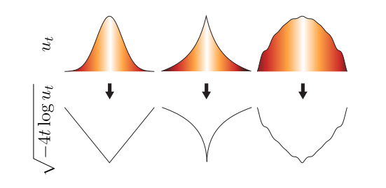
Varadhan’s Formula
As we saw in the last slide, Varadhan’s formula is a relationship between the heat kernel function and the distance.
If so, we have an equation that for given heat function will plot the distance between two point, so why do we bother writing this presentation?
The problem is that when given exact reconstruction of the heat kernel Varadhan’s formula can be used for recover geodesic distance, but fails when we use an approximation of the heat kernel or if any numerical errors present.

Slide 8
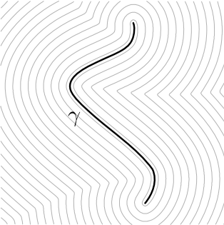
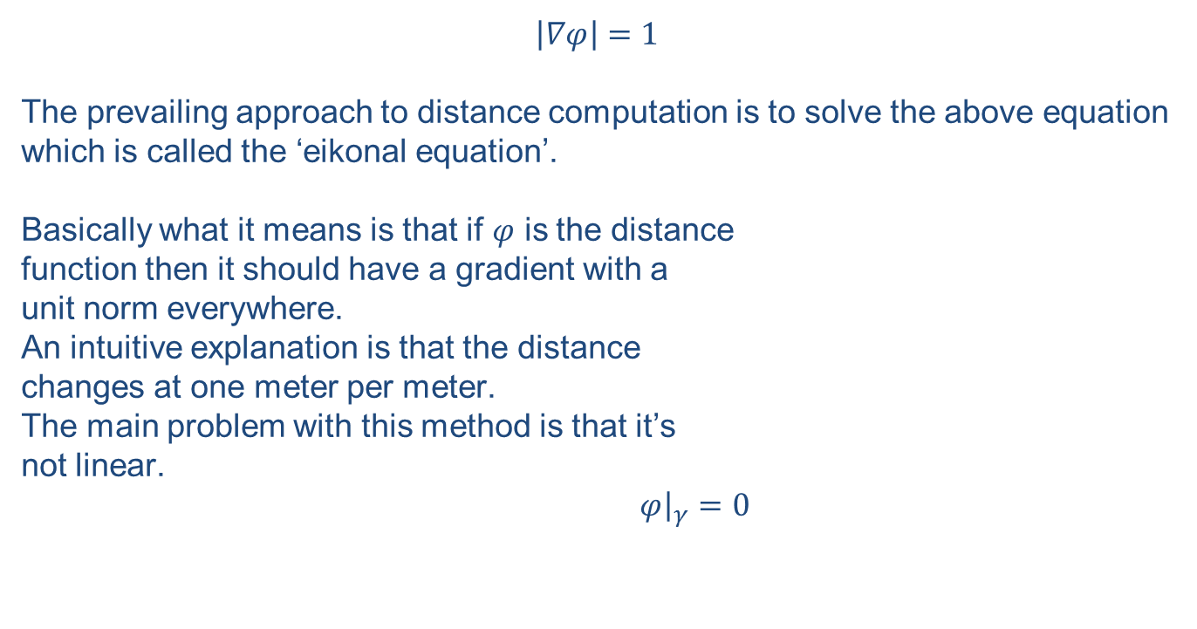
Eikonal Equation
$$\left|∇φ\right|=1$$
The prevailing approach to distance computation is to solve the above equation which is called the ‘eikonal equation’.
Basically what it means is that if $φ$ is the distance
function then it should have a gradient with a
unit norm everywhere.
An intuitive explanation is that the distance
changes at one meter per meter.
The main problem with this method is that it’s
not linear.
$φ{\left.​\right|}_{γ}=0$

Slide 9
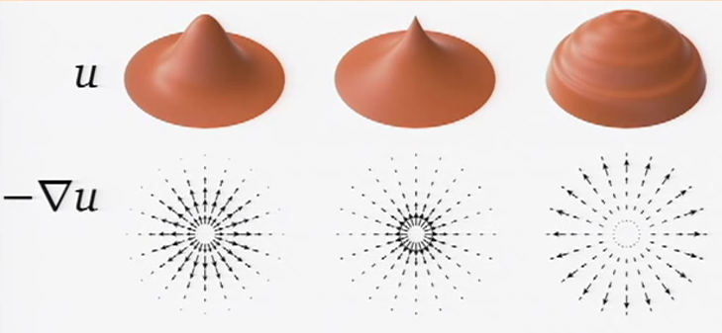
The Heat Method
Basically we can take any radially symmetric function which decays monotonically with distance and we will get a gradient field which points to the right direction, but with the wrong magnitude.

Slide 10
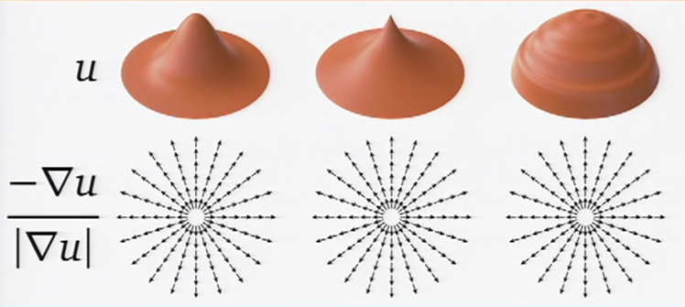

The Heat Method
So we have the gradient field pointing to the right direction, but what about the magnitude?
That’s where the eikonal equation comes in place. We know that $\left|∇φ\right|=1$, so we can just normalize the gradient field and get the right magnitude as well.

Slide 11
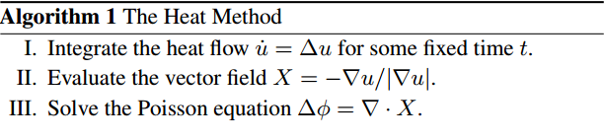
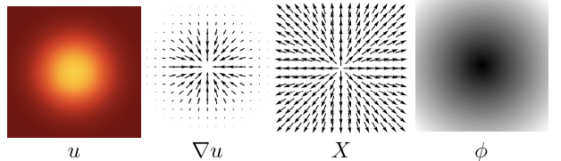
The Heat Method
The heat method consists of 3 basic steps:

Slide 12
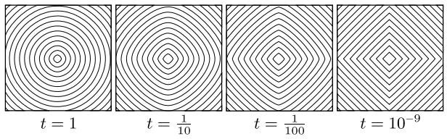
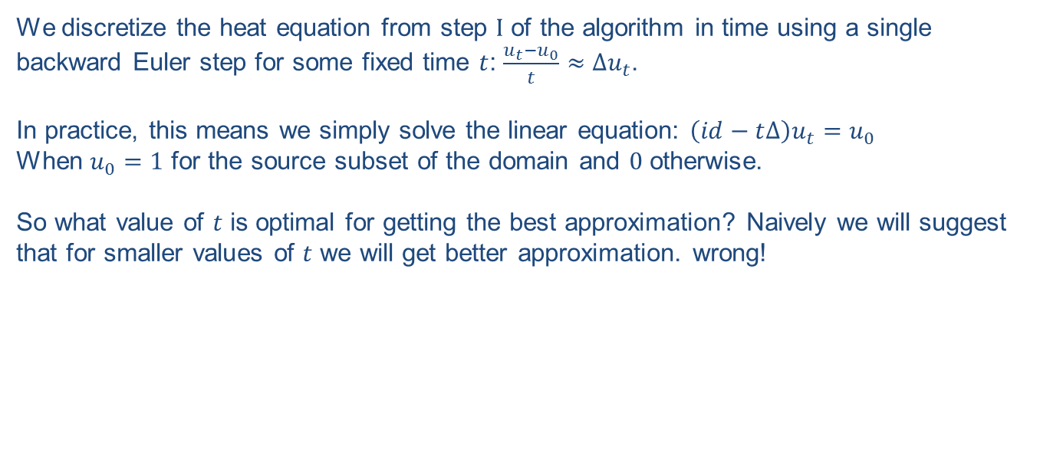
Time Discretization
We discretize the heat equation from step $Ι$ of the algorithm in time using a single backward Euler step for some fixed time $t$: $\frac{u_{t}−u_{0}}{t}≈∆u_{t}$.
In practice, this means we simply solve the linear equation: $\left(id−t∆\right)u_{t}=u_{0}$
When $u_{0}=1$ for the source subset of the domain and $0$ otherwise.
So what value of $t$ is optimal for getting the best approximation? Naively we will suggest that for smaller values of $t$ we will get better approximation. wrong!

Slide 13
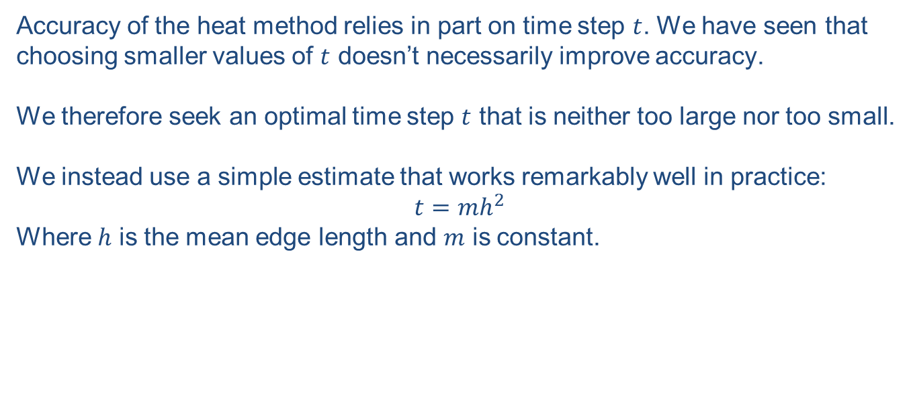
Choosing Optimal Timestep
Accuracy of the heat method relies in part on time step $t$. We have seen that choosing smaller values of $t$ doesn’t necessarily improve accuracy.
We therefore seek an optimal time step $t$ that is neither too large nor too small.
We instead use a simple estimate that works remarkably well in practice:
$$t=mh^{2}$$
Where $h$ is the mean edge length and $m$ is constant.

Slide 14
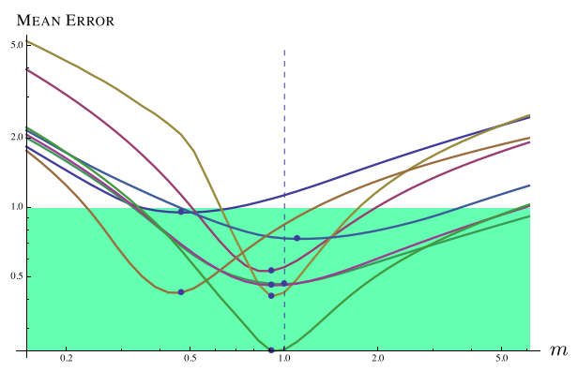

Choosing Optimal Timestep
Experiments on a regular grid suggest that $m=1$ is a good parameter value which yields near-optimal accuracy for a wide variety of irregularly triangulated surfaces.

Slide 15
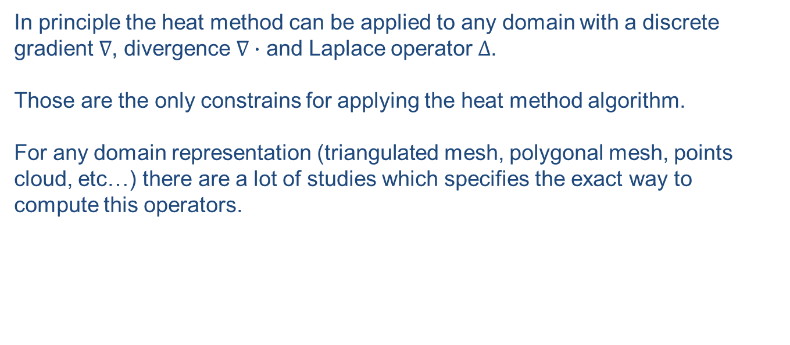
Spatial Discretization
In principle the heat method can be applied to any domain with a discrete gradient $∇$, divergence $∇∙$ and Laplace operator $∆$.
Those are the only constrains for applying the heat method algorithm.
For any domain representation (triangulated mesh, polygonal mesh, points cloud, etc…) there are a lot of studies which specifies the exact way to compute this operators.

Slide 16
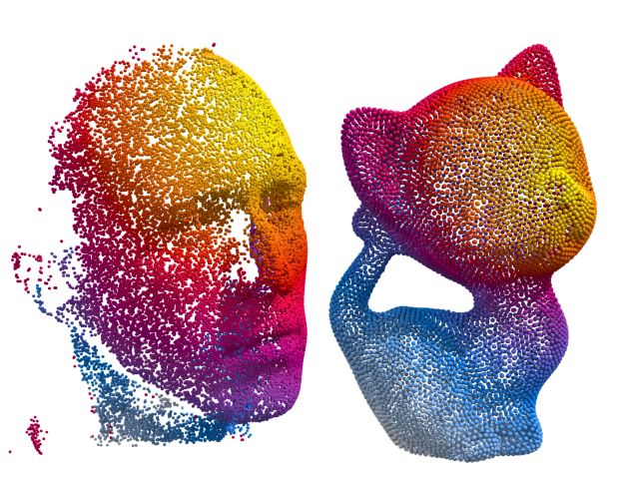
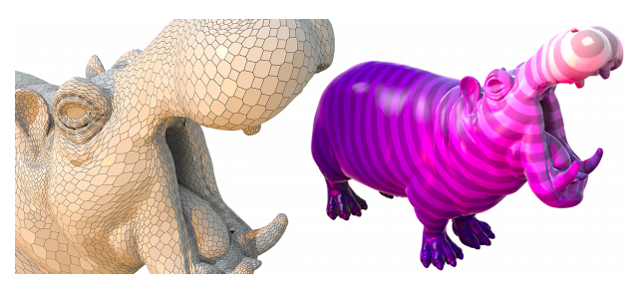
Spatial Discretization

Slide 17
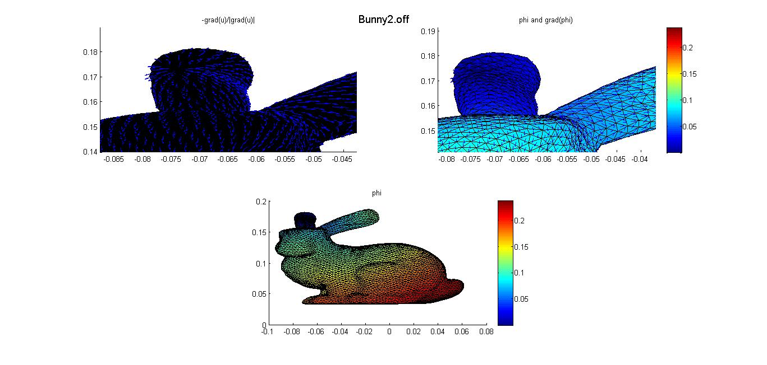
Results

Slide 18
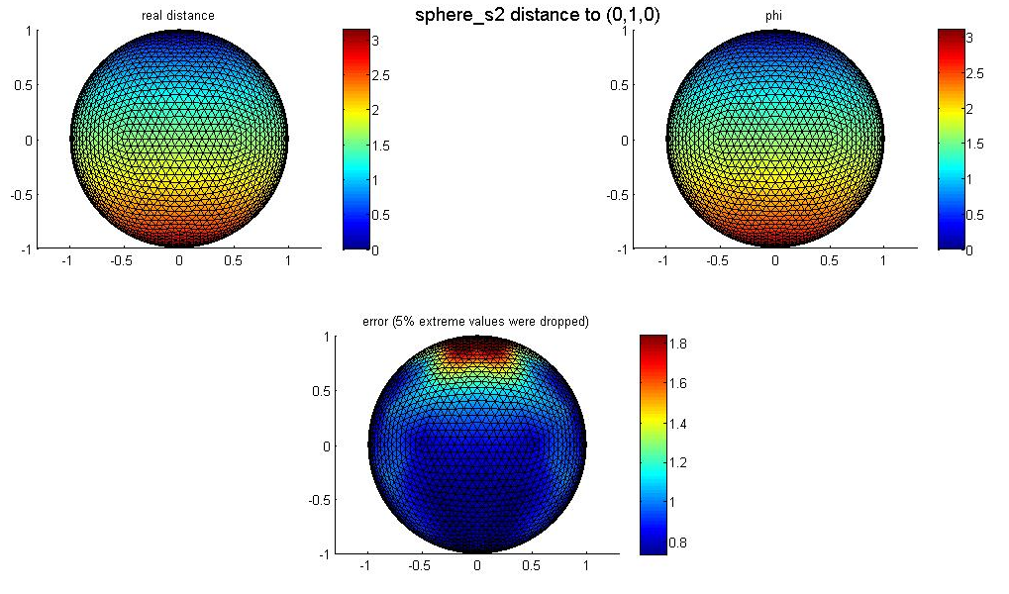
Distance from a single point source

Slide 19
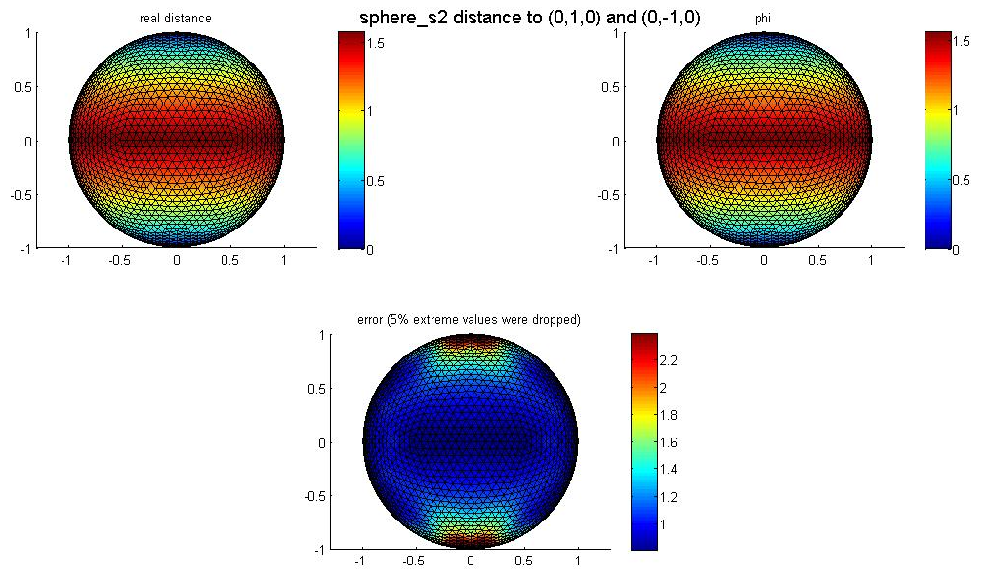
Distance from a two points source

Slide 20
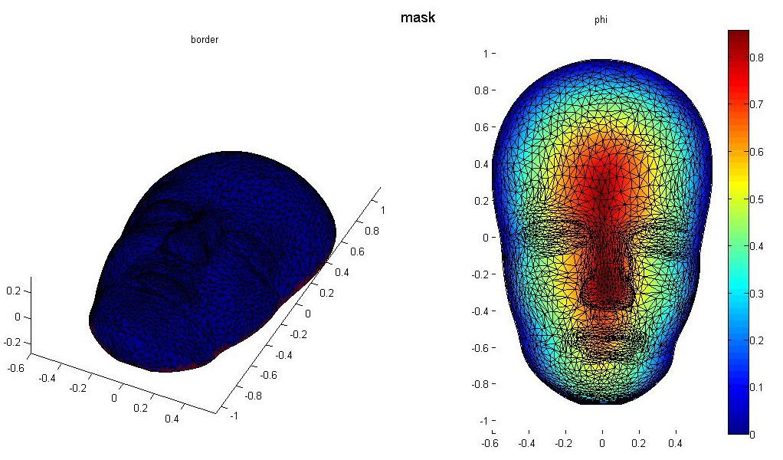
Mask – A single boundary

Slide 21
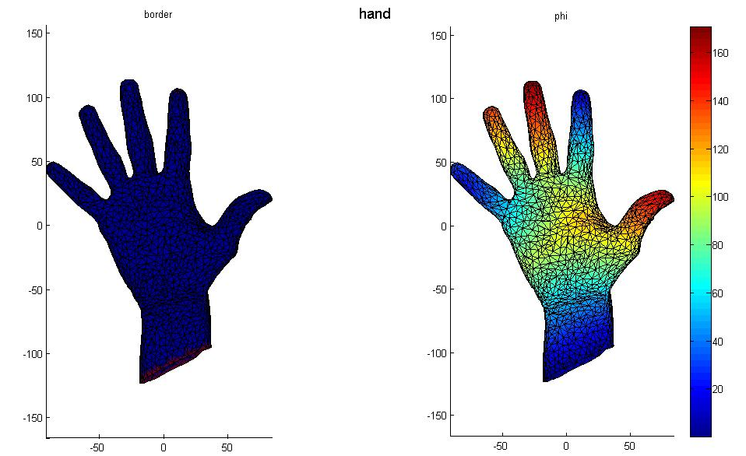
Hand - Three boundaries

Slide 22
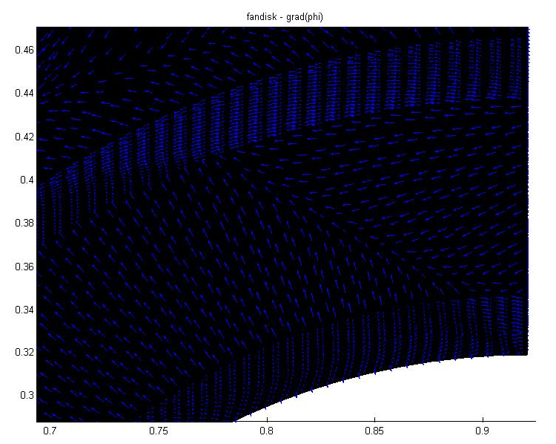
Fandisk – Mesh with creases - gradient

Slide 23
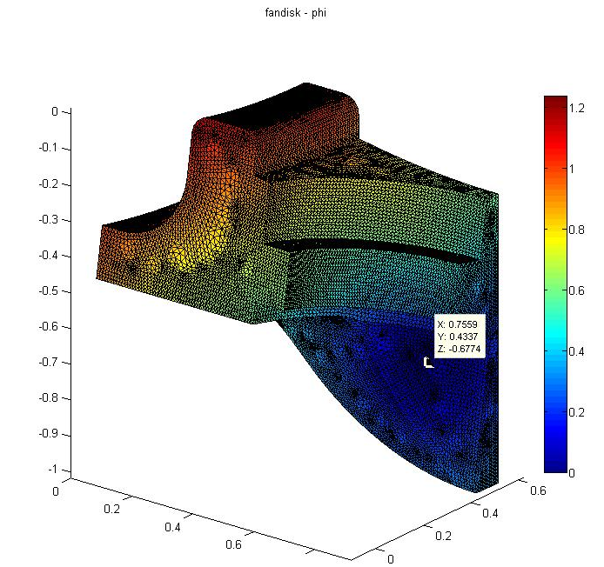
Fandisk – Mesh with creases - distance

Slide 24
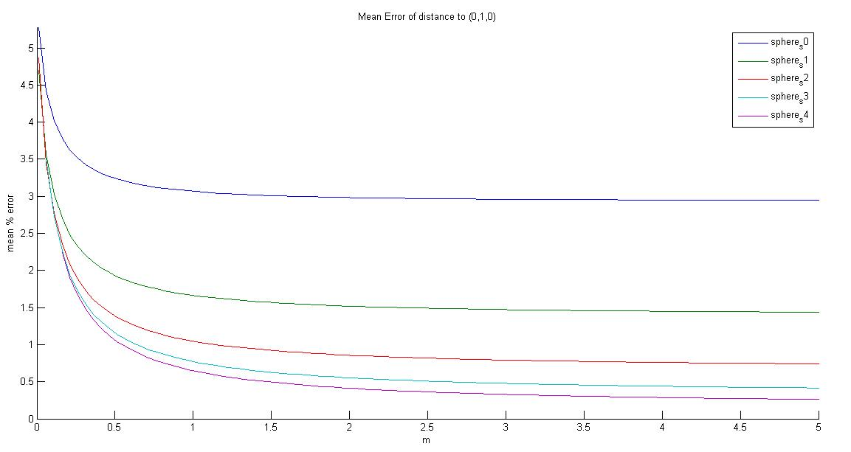
Mean error percentage

Slide 25
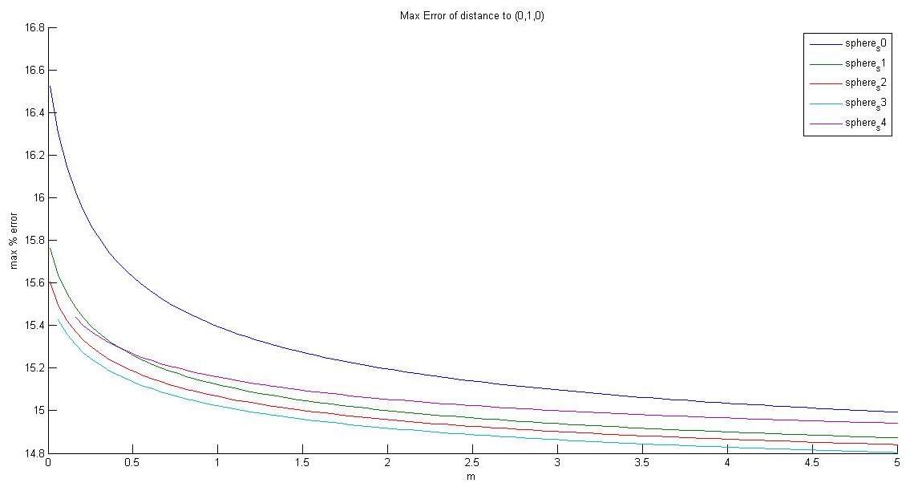
Maximum error percentage

Slide 26
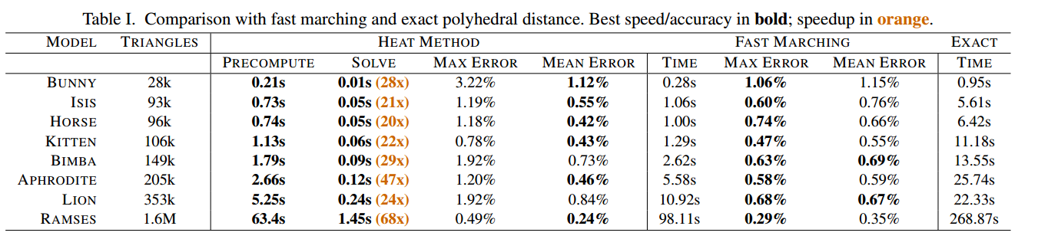
Results Shown in the Paper
Benchmarks

Slide 27
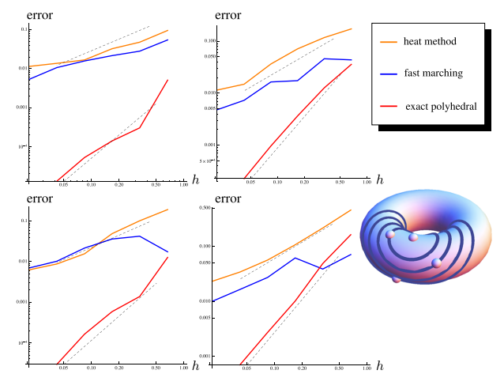
Results Shown in the Paper
Error dependent in mean edge length

